Slide 1
Machine Consciousness

Slide 2
Aspects of Consciousness
->State or quality of awareness
Being aware of external object or something within oneself
->Memory
Conscious events interact with memory systems in learning rehearsal and retrieval
->Learning
To enable agents to afford flexible control over their actions in complex, unpredictable environments

Slide 3
Machine Consciousness
It is a field related to artificial intelligence and cognitive science the aim of artificial consciousness is to define that which would have to be synthesize where consciousness to be found in a engineered artifact.
A machine is conscious IFF besides ability to perceive, act, learn and remember, it has a central executive mechanism that controls all the processes (conscious or subconscious) of the machine;

Slide 4
Autonomy vs Intelligence vs Consciousness
Autonomy
Systems capable of operating in real world environment without any form of external control
Intelligence
Involves the ability to reason, plan, solve problems and learn from experience
A system can be autonomous but not an intelligent
example: earth worm
Or it can be intelligent but not autonomous
example: a supercomputer

Slide 5
Consciousness
Can be described as a state or awareness of being self-aware including:
Subjectivity: Our own ideas and sensations are experienced directly
Unity: All sensor modalities melded into one experience
Intentionality: Experiences have meaning beyond the current moment

Slide 6
MIRROR TEST
One simple test for this is the “mirror test” a spot of colour is placed on the test subject and when the subject looks in the mirror they recognize that they are seeing themselves (maybe by trying to touch the spot on their own body not the mirror). Humans older than 18 months, great apes, bottlenose dolphins, pigeons, elephants, and magpies all pass this test and show apparent self-awareness.

Slide 7
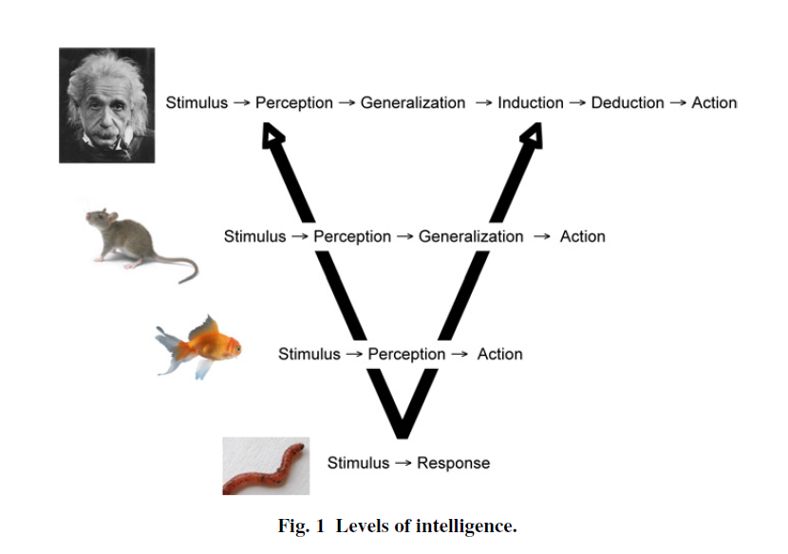
The figure show the levels of intelligence. Many people believe the mammals have some level of consciousness or at-least self-awareness.

Slide 8
Computational Barrier
Minimum level of computation necessary to achieve human like consciousness: can be calculated using Neural networks
The human brain has about 10¹² neurons, and each neuron makes about 10³ synaptic connections with other neurons, on average, for a total of 10¹⁵ synapses.
Neural Network : each synapse : 4bytes
10¹⁵ synapses : 4million GB
Add auxiliary variables : 5 million GB !
Minimum prerequisite : Necessary, not sufficient condition
Even the most powerful current supercomputer, the IBM RoadRunner with 6,562 dual-core AMD Opteron chips and 12,240 Cell chips, cannot compare to the human brain. The RoadRunner has 9.8 × 1013 bytes of memory (98 terabytes) and could sustain 1015 operations per second (1 peta-flop) peak speed.

Slide 9
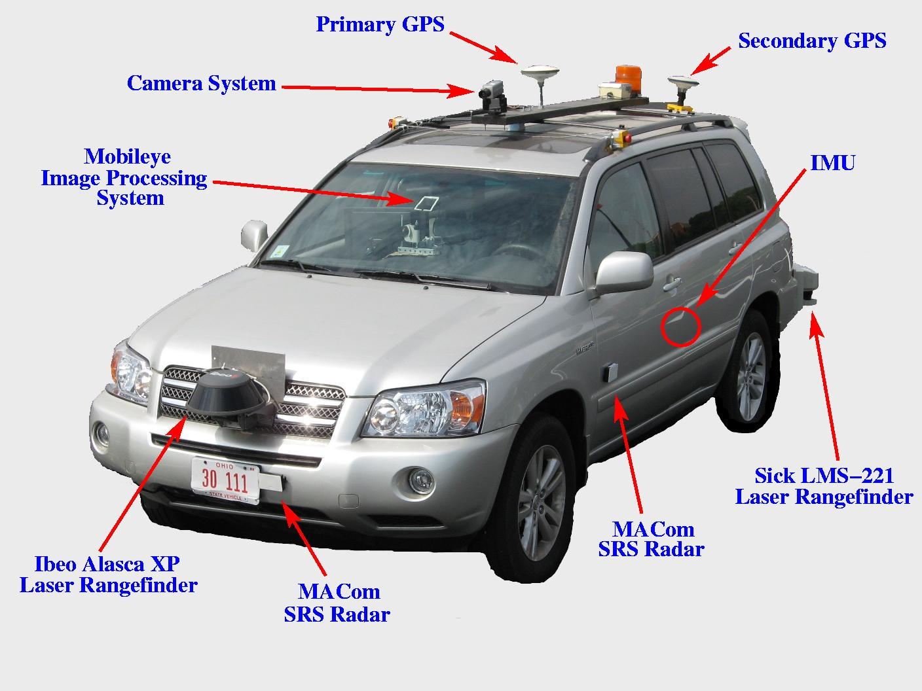
Human sensory systems use hundreds of millions of cells, and there are roughly 600 muscles in the human body. The fascinating robotic vehicles in the DARPA Urban Challenge have very few sensor systems (e.g., lasers, cameras, and radar) and very few motor-control output channels.
Robotic vehicles DARPA
They also required millions of lines of software and teams of engineers, and they still have little or no learning ability.

Slide 10
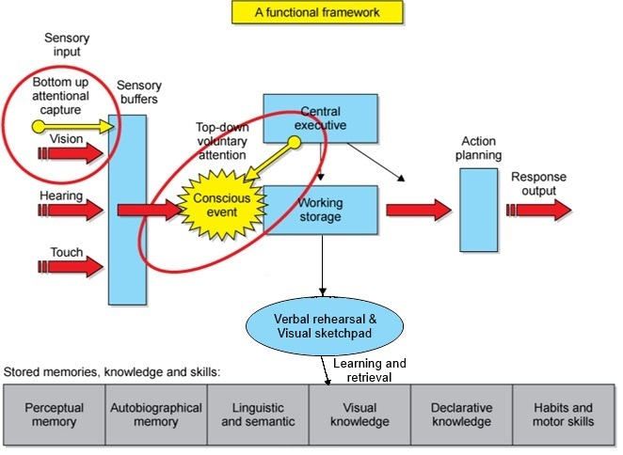
Developing Conscious Systems
Five axioms:
Depiction, Imagination, Attention, Planning and Emotion
Human consciousness comes about from a highly interconnected complex system of systems using nonlinear spiking neural networks to perform data fusion on vast amounts of input data to learn, to store memories, to think, and to control a complex motor subsystem.

Slide 11
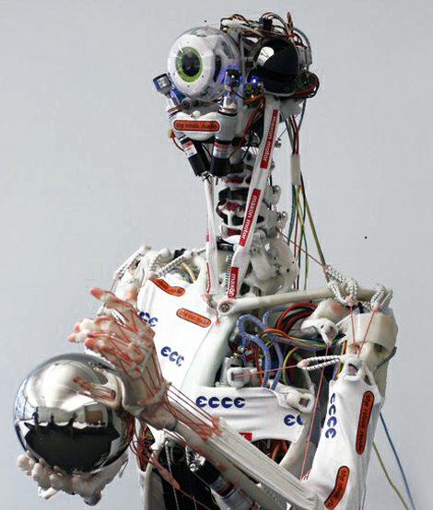
Projects and On-going Researches
CRONOS:
One of the few large projects that has been explicitly funded to work on machine consciousness.
It consists of
CRONOS, hardware robot closely based on the human musculoskeletal system.
SIMNOS, a soft real time physics-based simulation of this robot in its environment.
biologically inspired visual
system, and a spiking neural simulator called Spikestream.

Slide 12
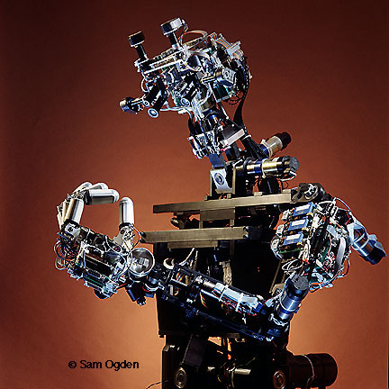
COG:
Focused on different aspects of human cognition and behaviour such as joint attention and theory of mind, social interaction, dynamic human-like arm motion and multimodal coordination.
consisted of a torso, head and arms
control of a heterogeneous network of programs
stereo foveated vision, microphones, piezoelectric touch sensors
robot also had a simple emotional system and learn
number of hard wired reflexes
Visual processing

Slide 13
Criticism on Machine Consciousness
Hard problem of consciousness
Chalmers (1996) distinguishes between the easy problem of explaining how we can discriminate, integrate information, report mental states, focus attention, etc., and the hard problem of explaining phenomenal experience.
Consciousness is non-algorithmic.
Machine consciousness has also been criticised by Penrose (1990, 1995), who claims that the processing of an algorithm is not enough to evoke phenomenal awareness because subtle and largely unknown physical principles are needed to perform the non-computational actions that lie at the root of consciousness:

Slide 14
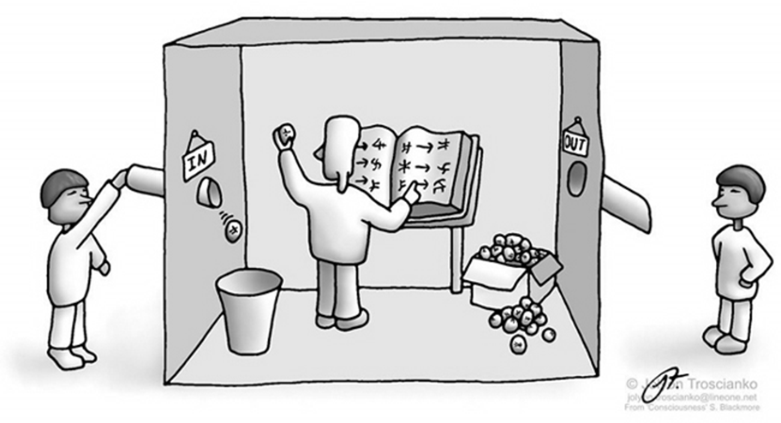
Chinese Room
Person inside the room is a non-speaker of Chinese
He is given Chinese symbols corresponding to questions
Instruction book in English telling him which symbol he has to output corresponding to the input
To the outside world,
he’s an excellent
speaker of Chinese.

Slide 15
Conclusions
Machine consciousness, it shares some common ground with philosophy, psychology, neuroscience, computer science and even physics, machine consciousness is rapidly developing an identity and problems of its own.
Achieving machine consciousness will be a harder and still a science-fiction thing as per our current developement.

